Slide 1
Mr. Xhafaj’s autobiography
Prepared on 08/22/2018

Slide 2
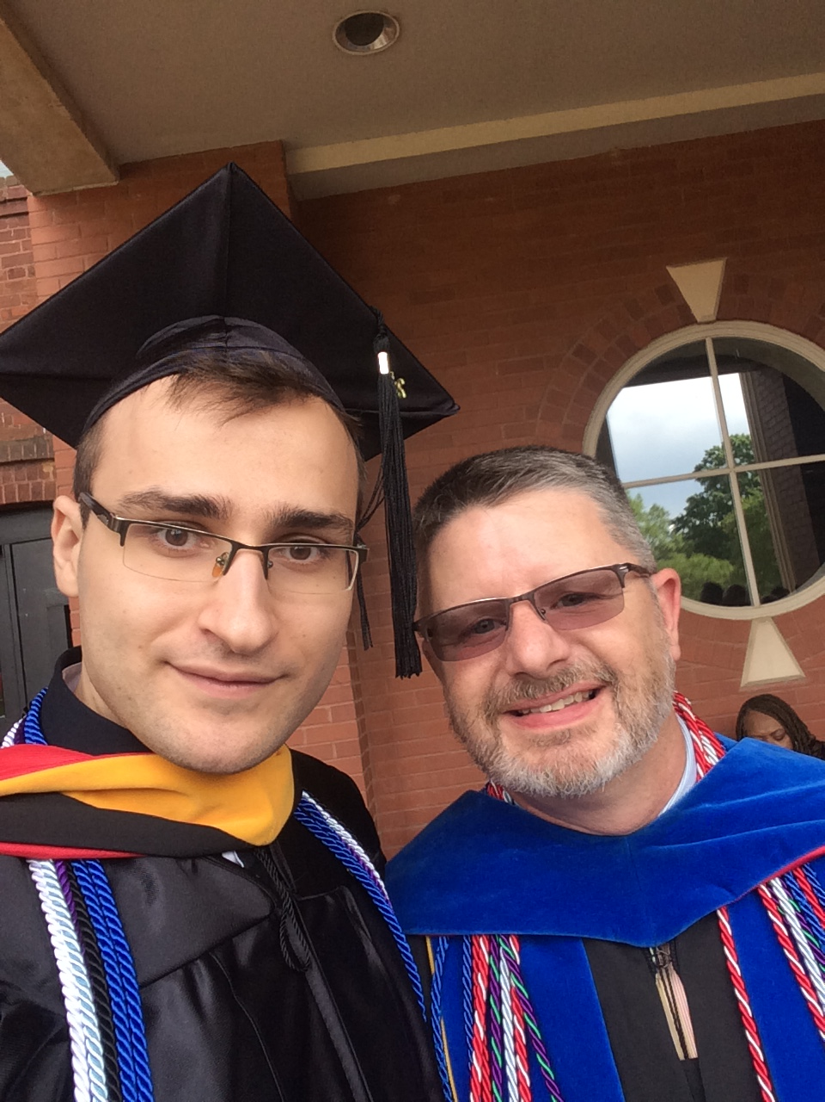
Who is Mr. Xhafaj?
Born in Albania
Came to US to complete college
Graduated from Newberry College in South Carolina
Bachelor’s of Science in Math with minor in Chemistry and concentration on Physics
Research on Oscillatory Integrals (Summer 2014, presented at MAA SE 2015)
Research on Girih Tiles (Summer 2015, presented at Research Day @ Newberry College 2016)
Currently finishing Master’s studies for Mathematics and Data Mining at TSU
Mr. Xhafaj
Favorite Professor at Newberry College

Slide 3
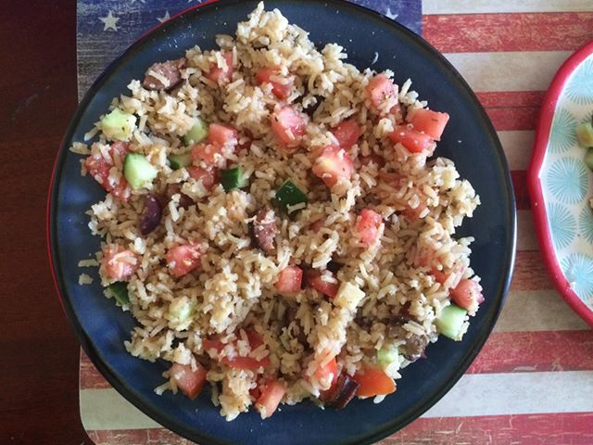
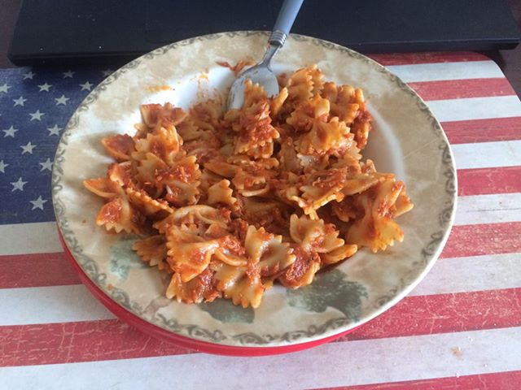
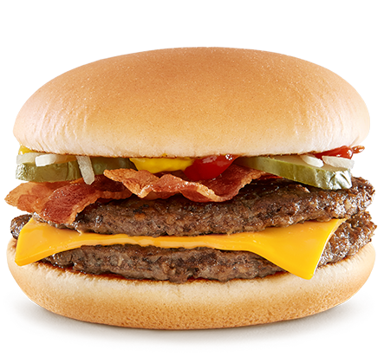
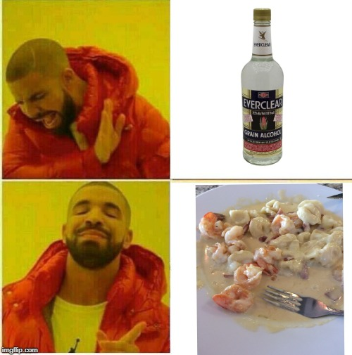
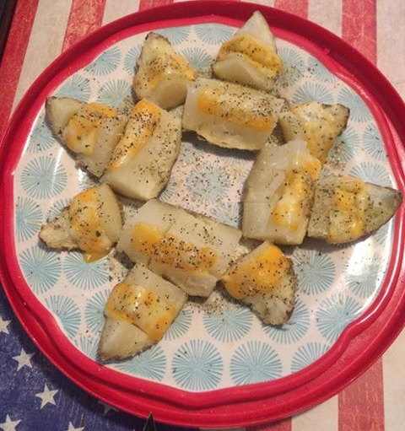
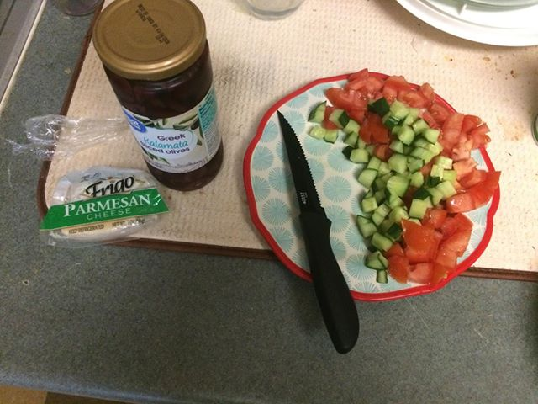
Likes : cooking & good food

Slide 4
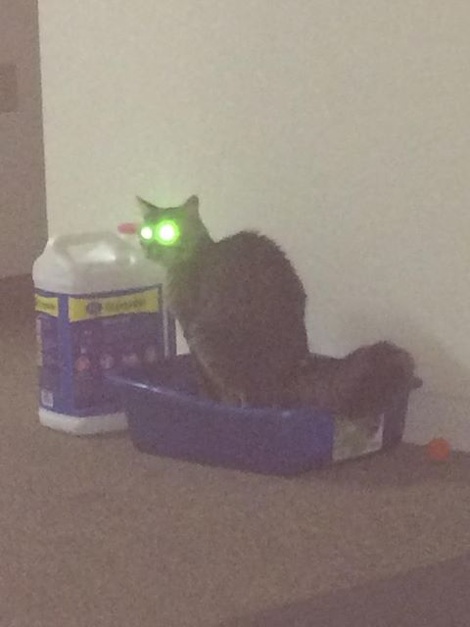
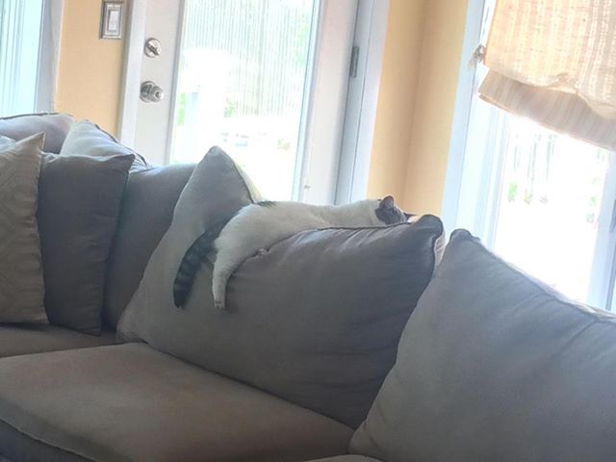
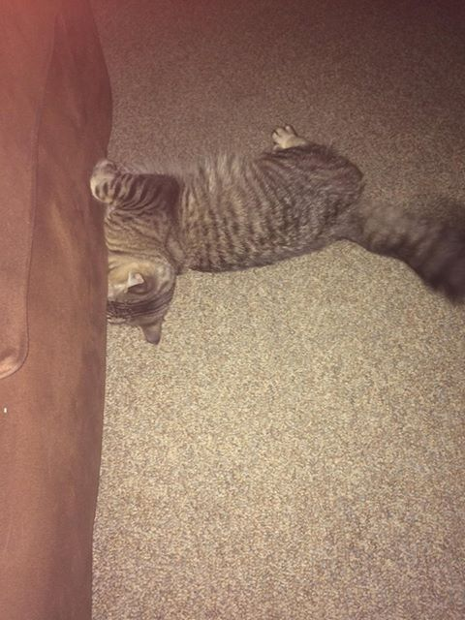
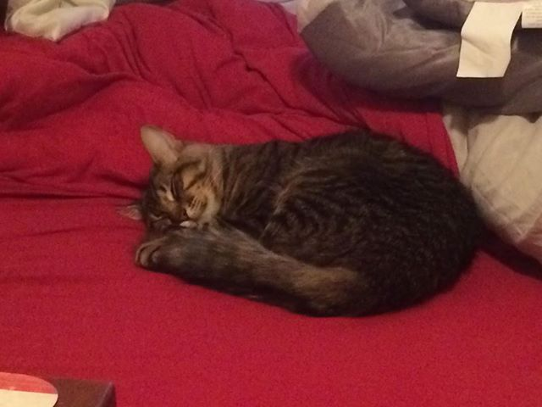
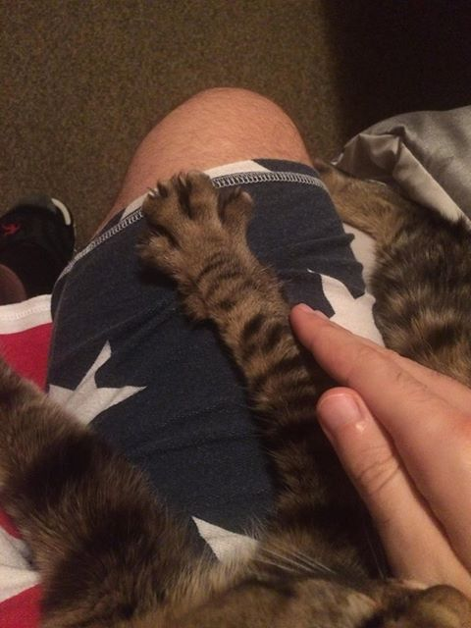
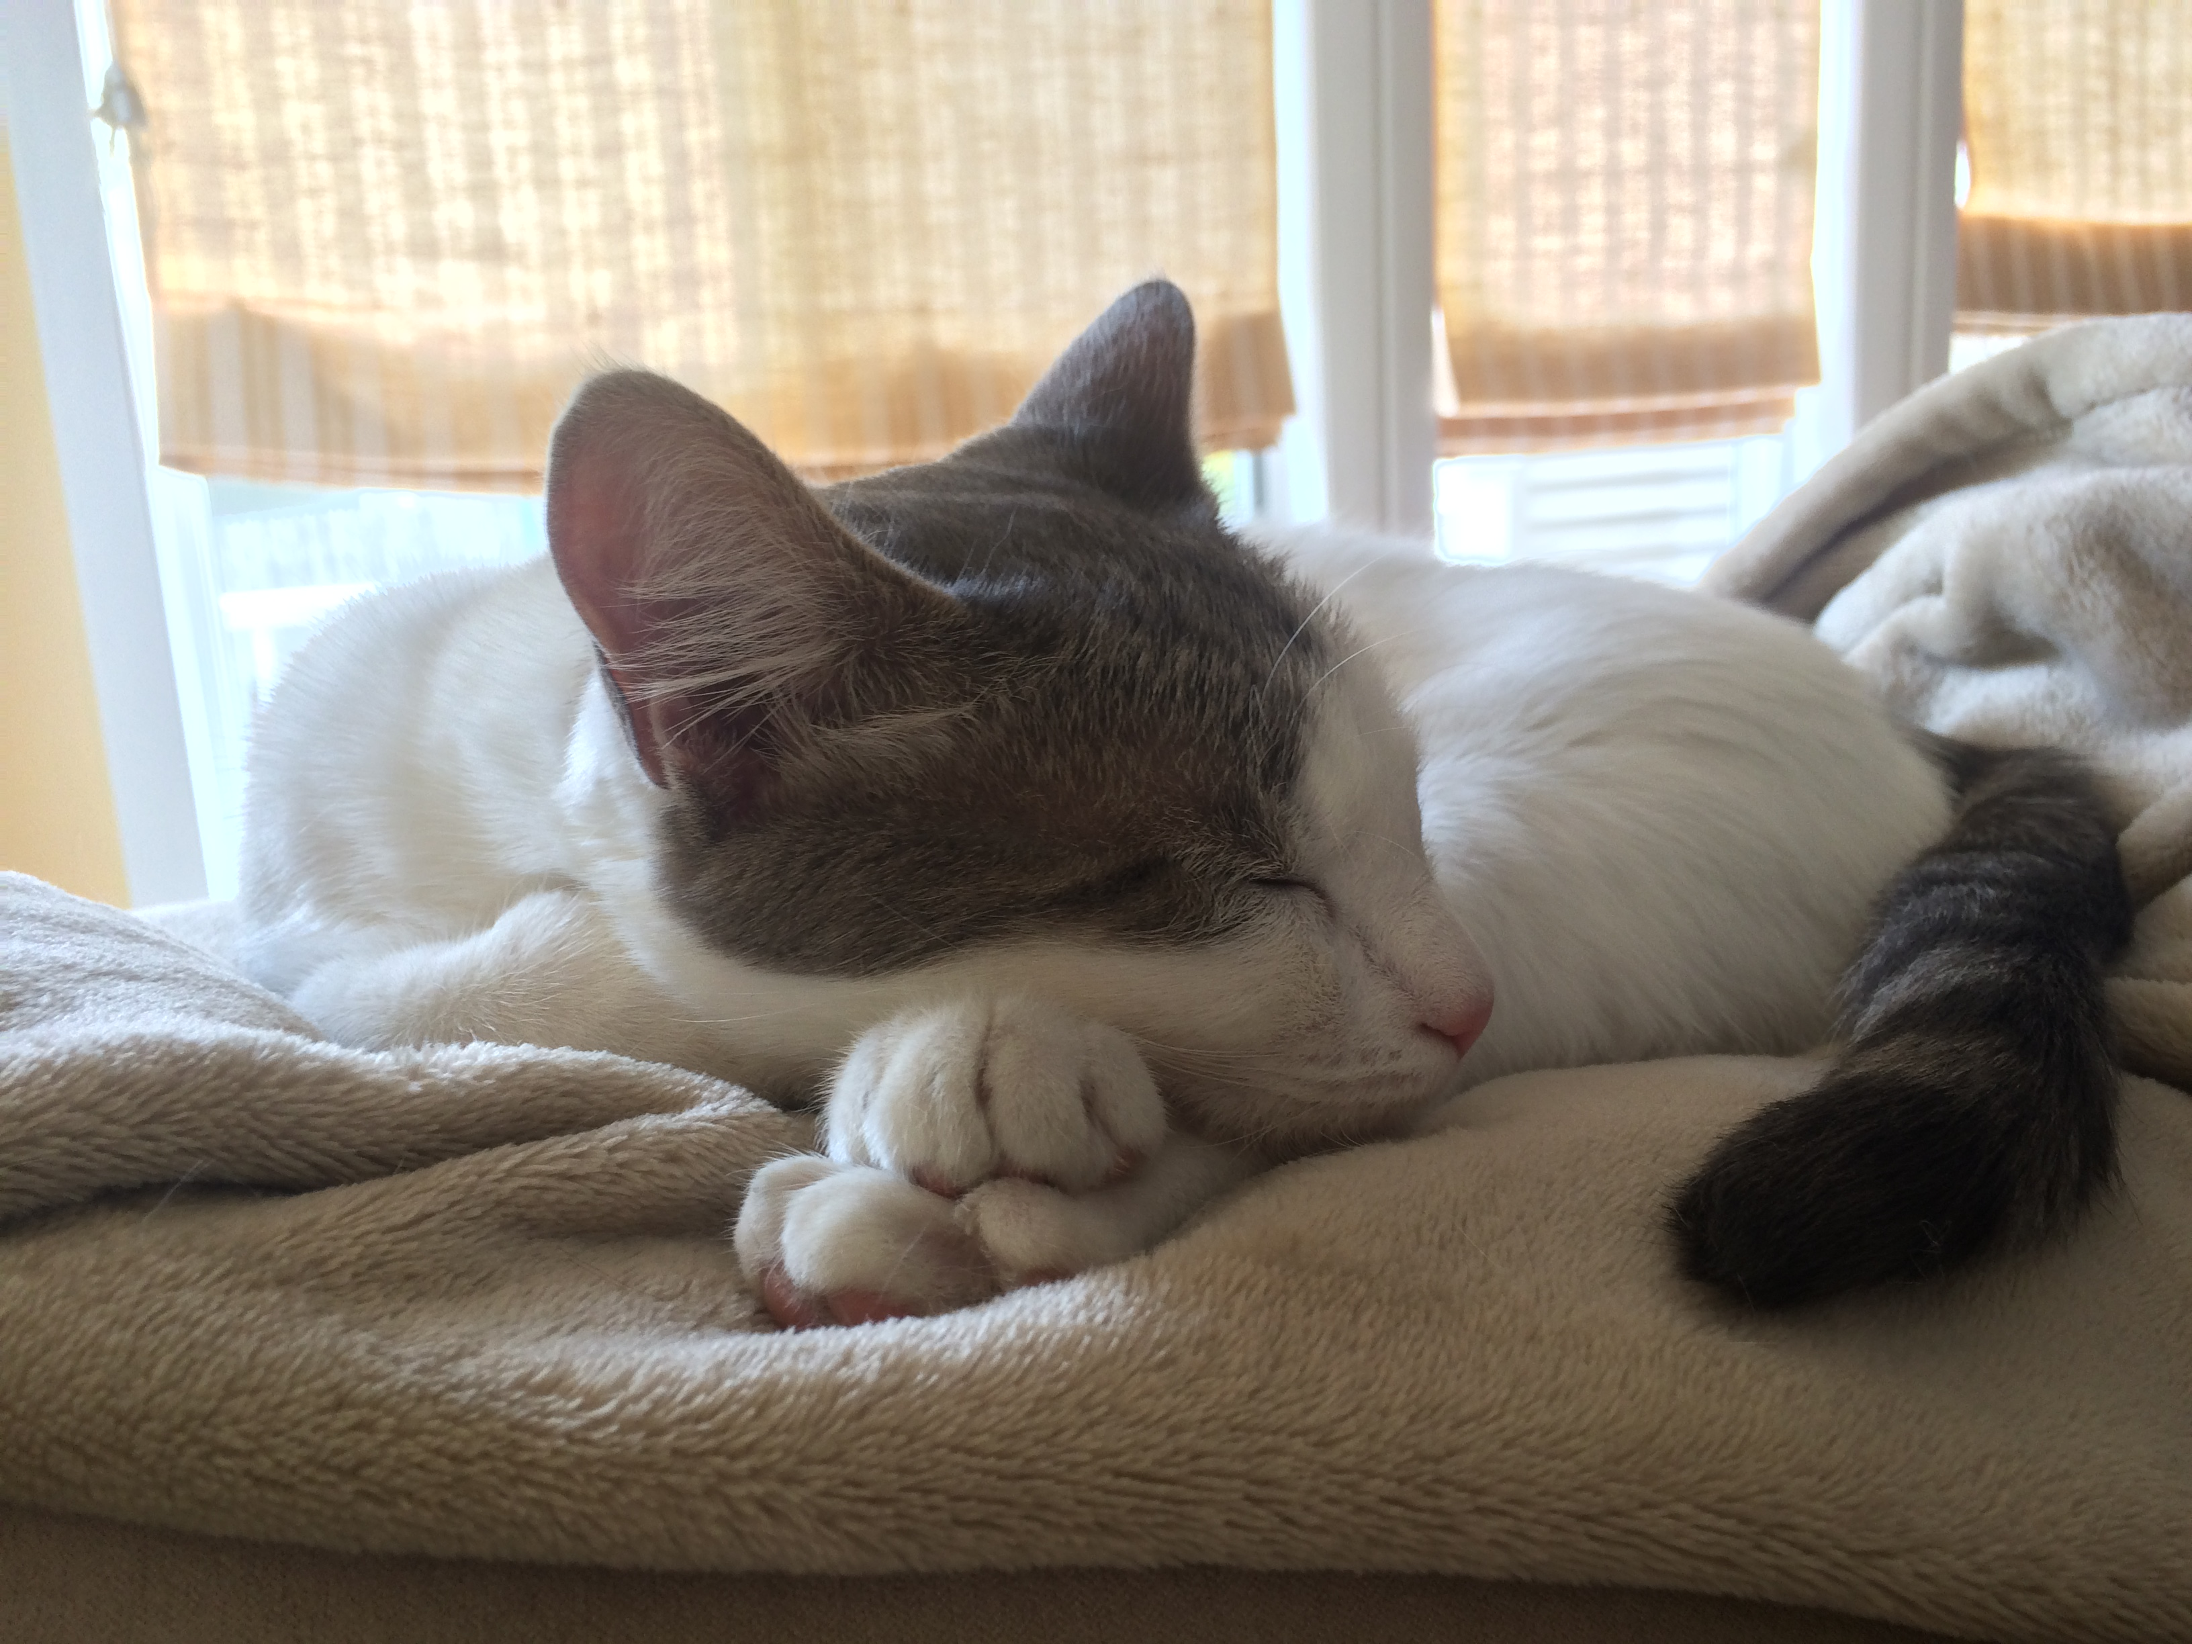
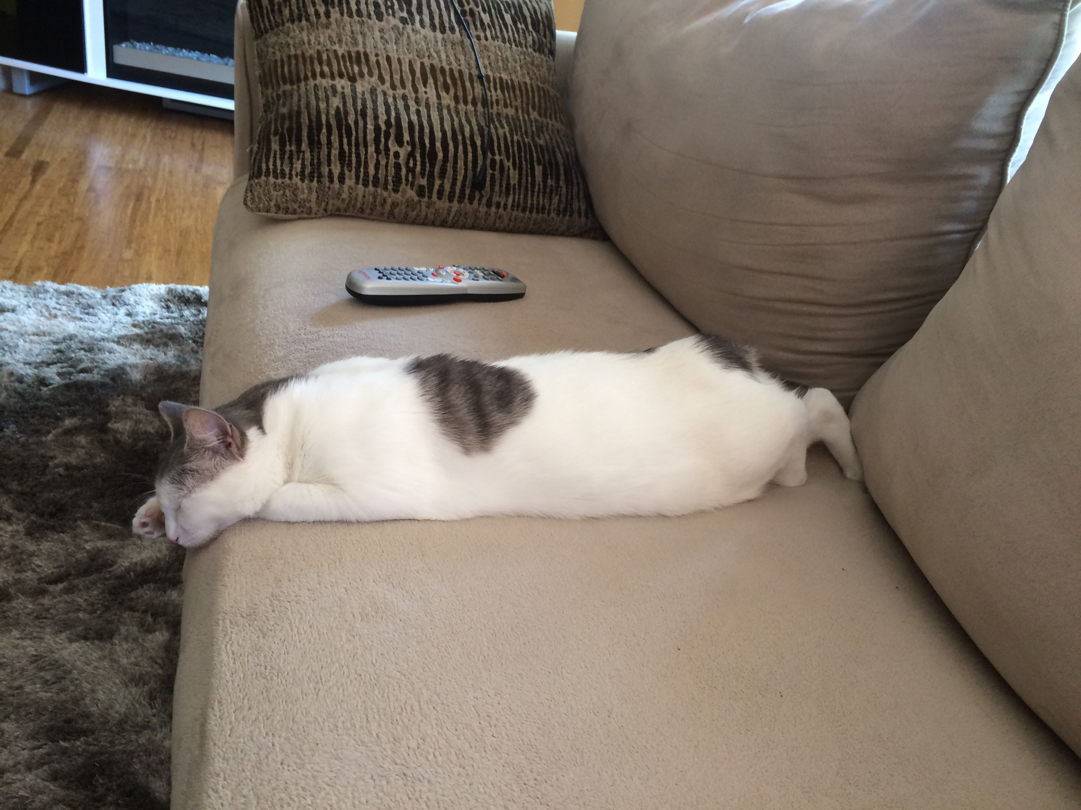
Enjoys the company of cats

Slide 5
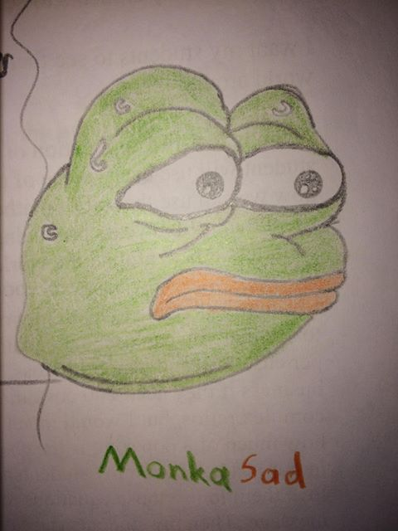
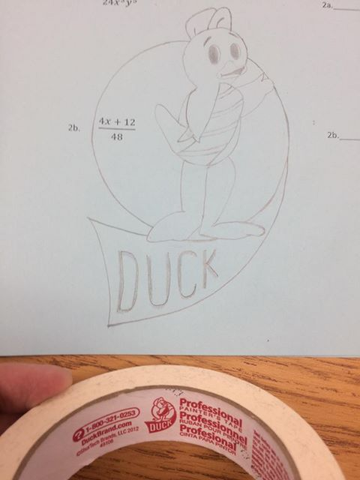
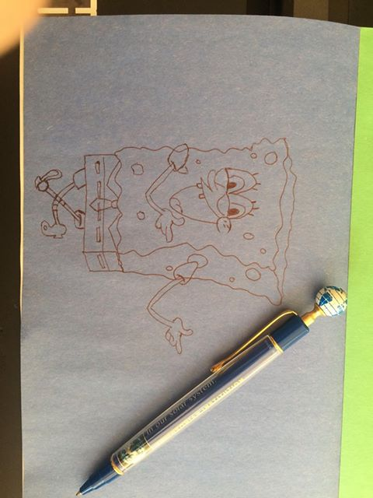
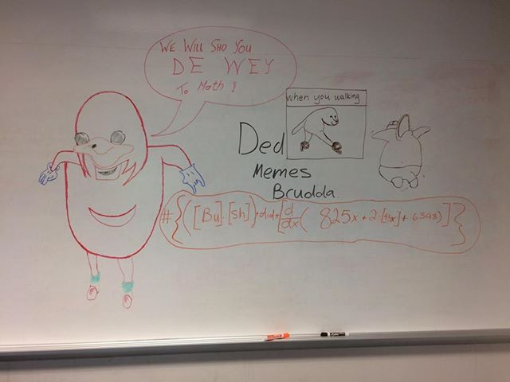
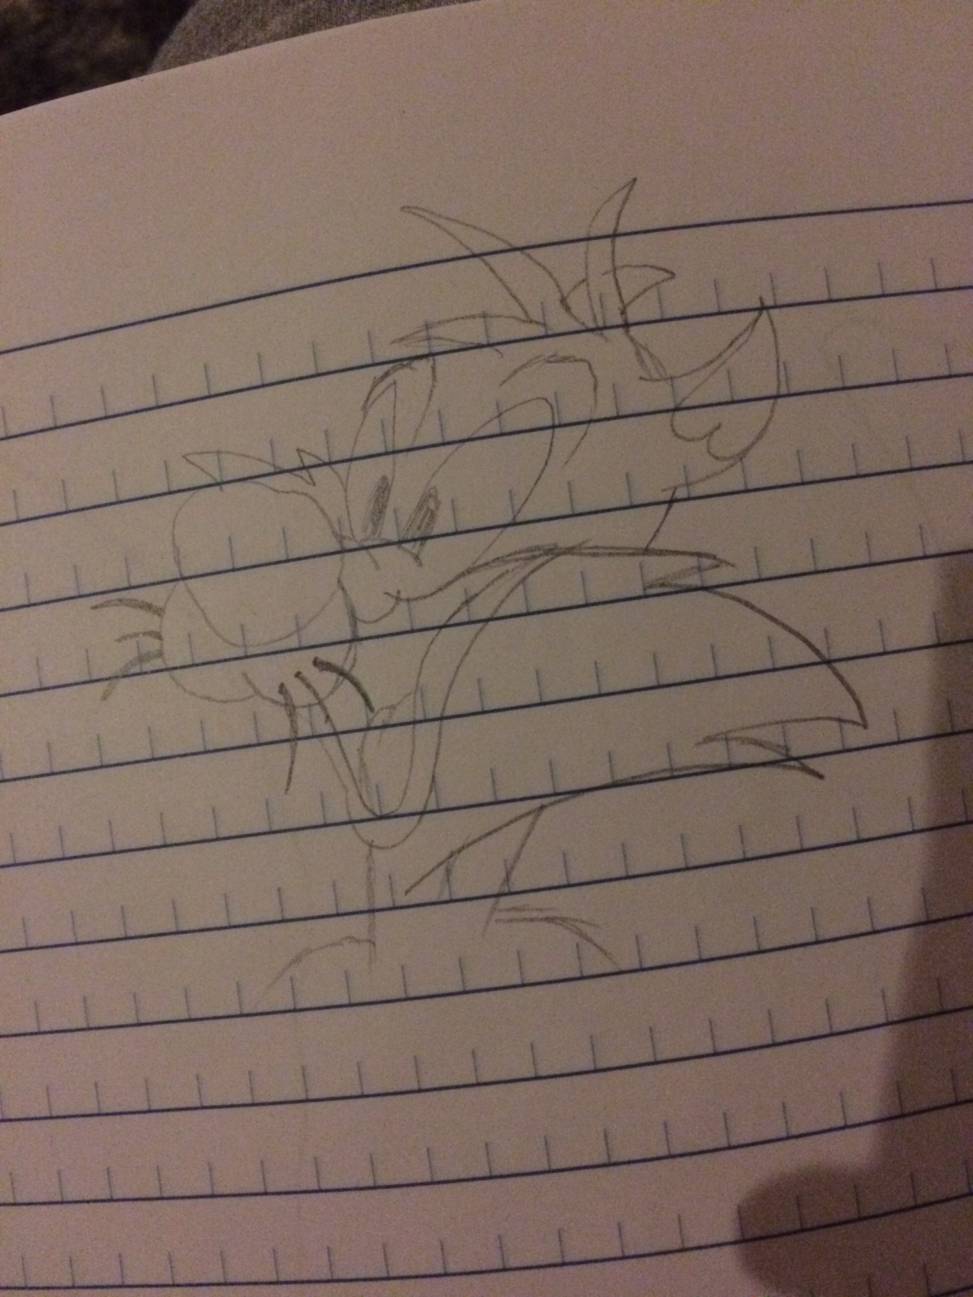
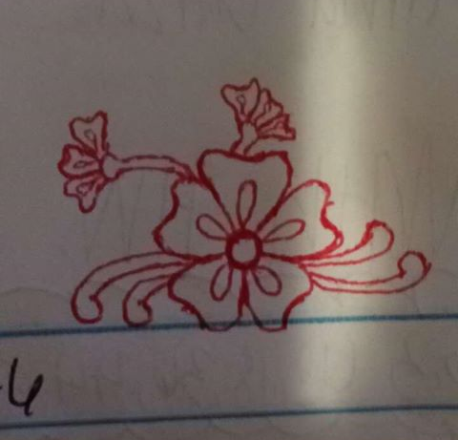
Tries to draw stuff (including memes)

Slide 6
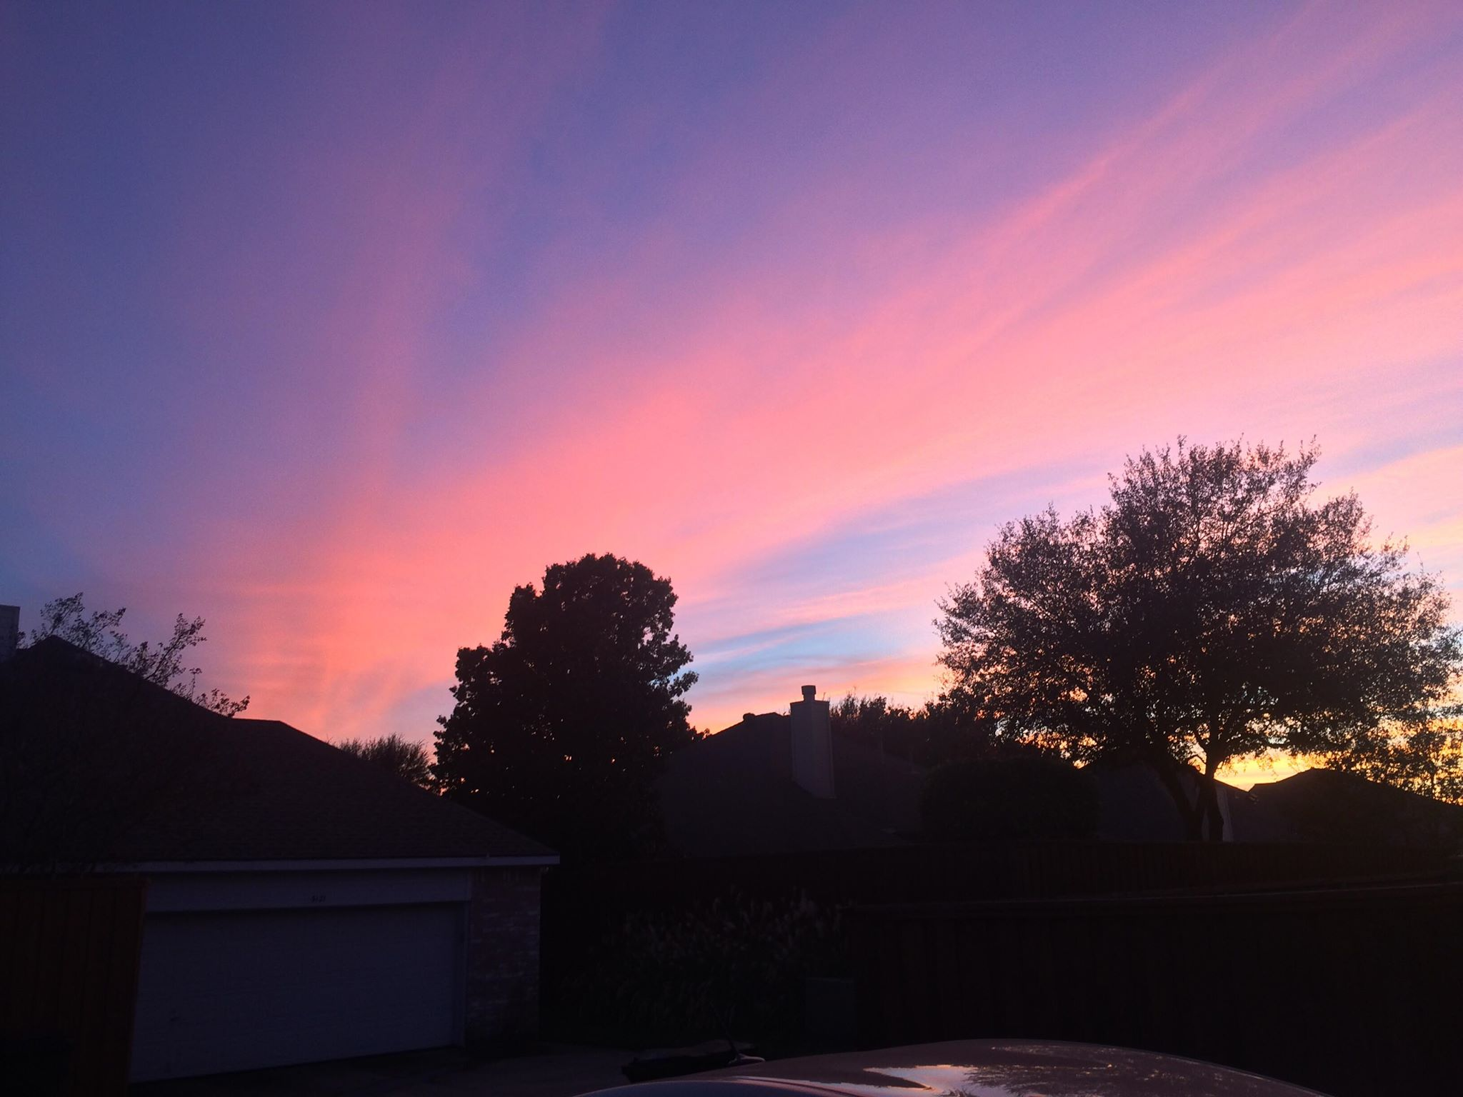
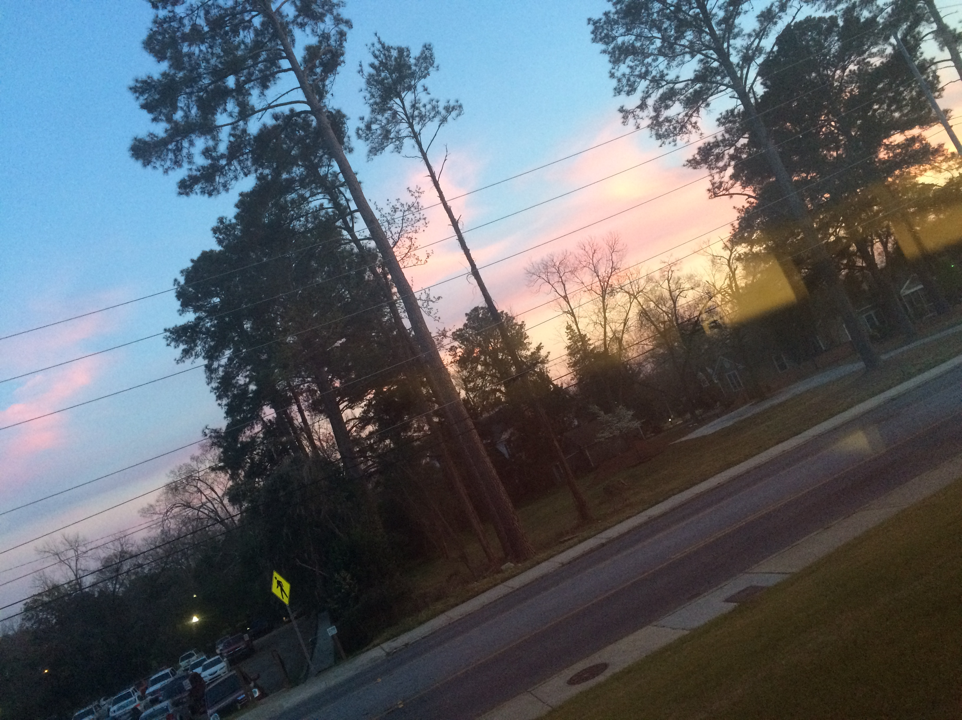
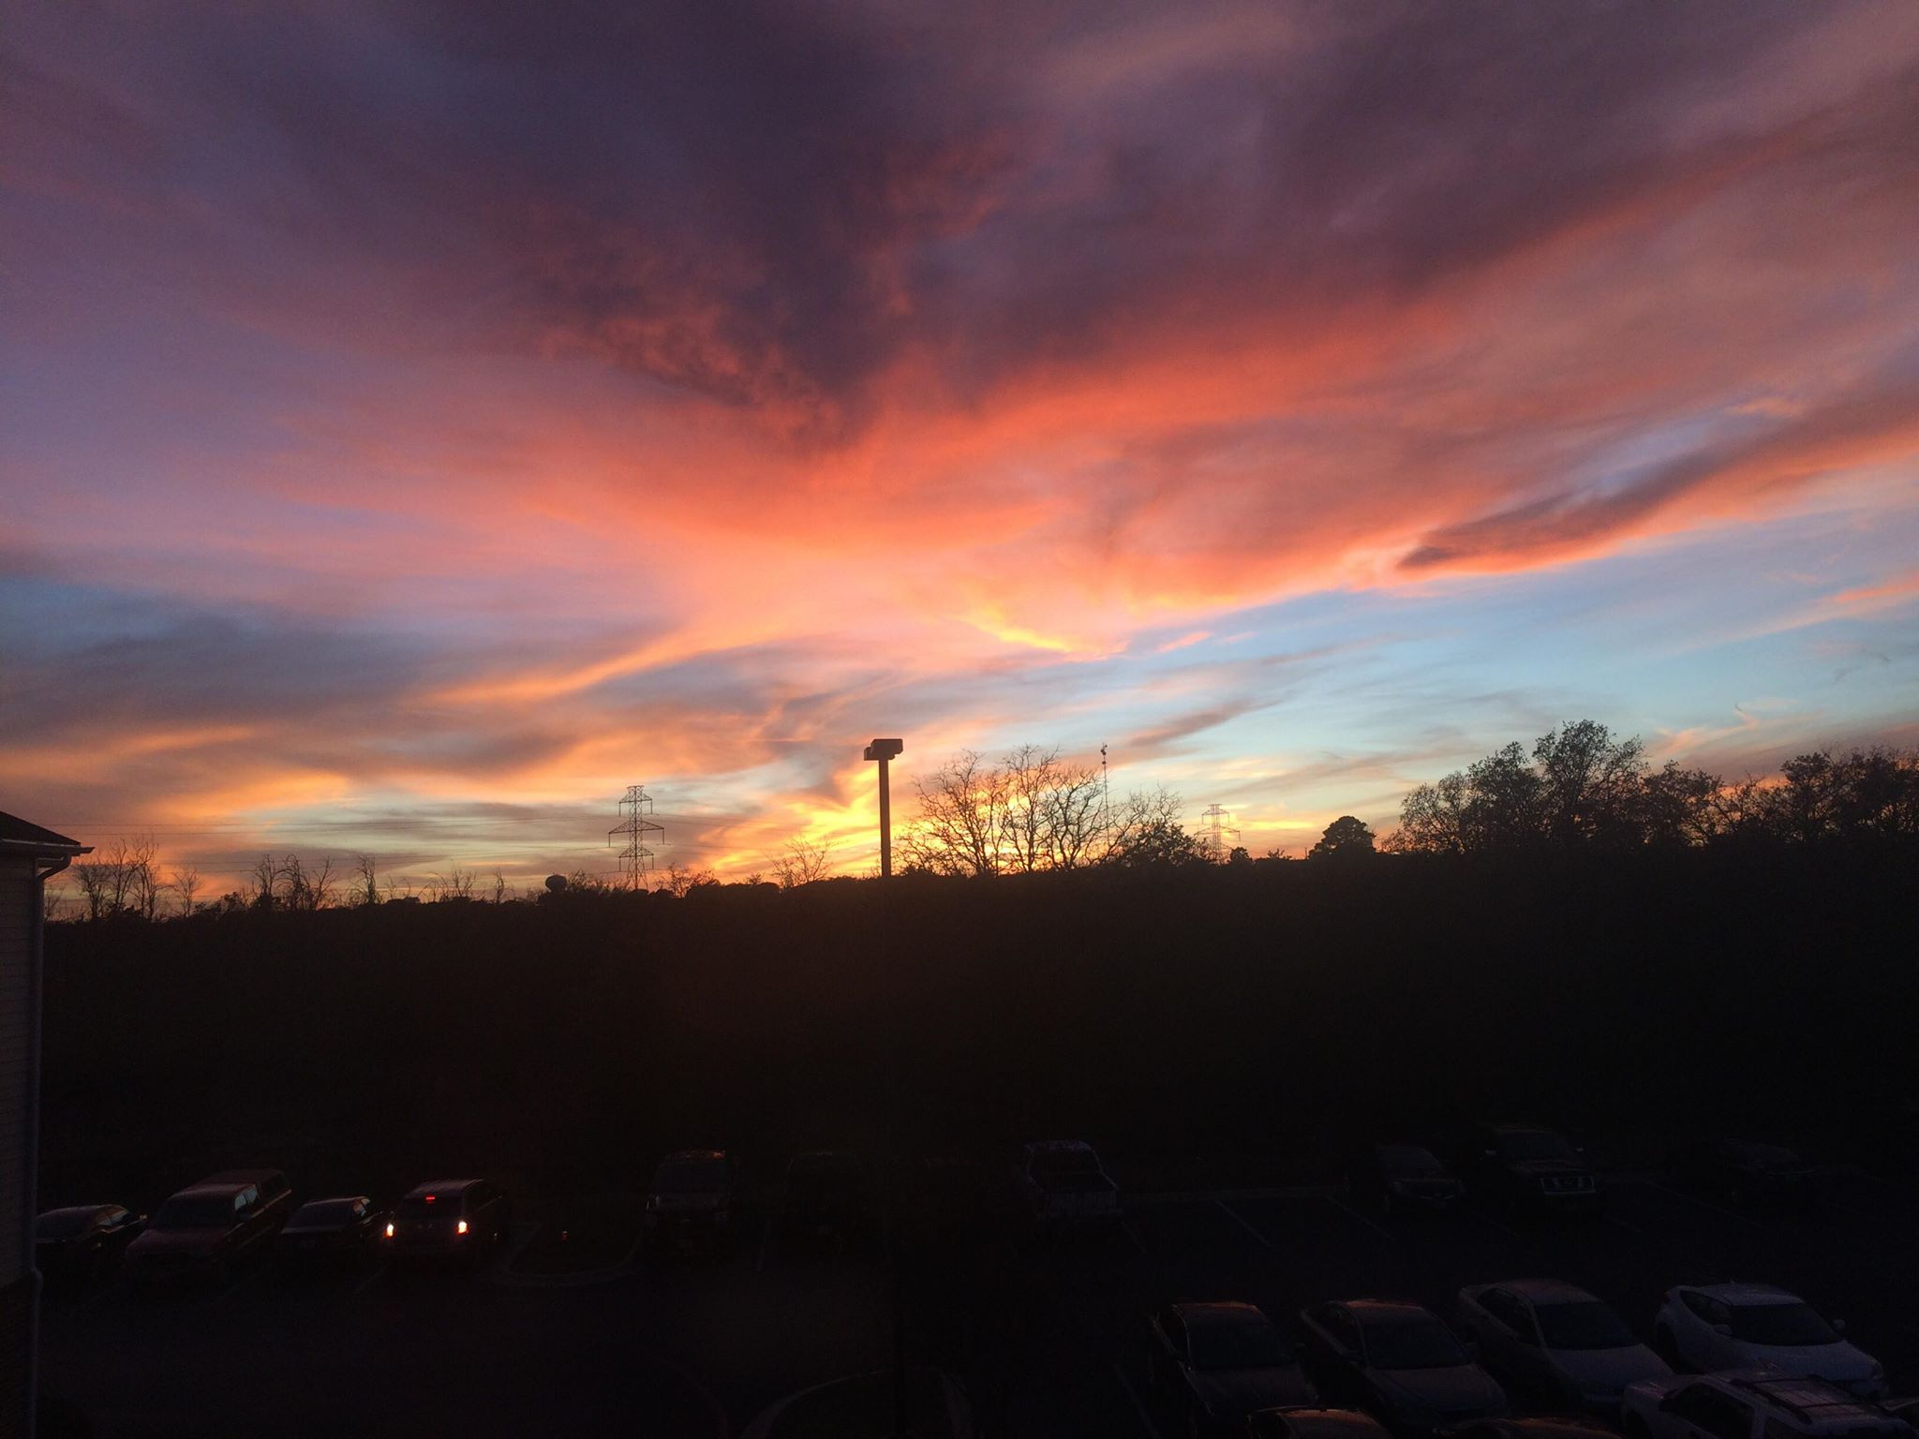
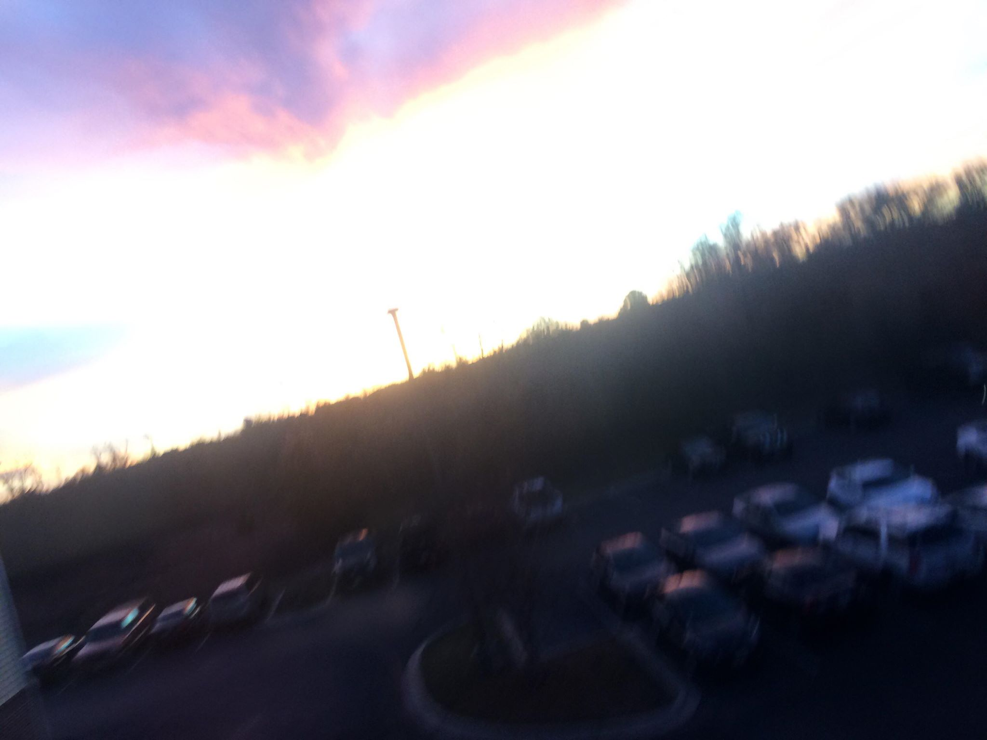
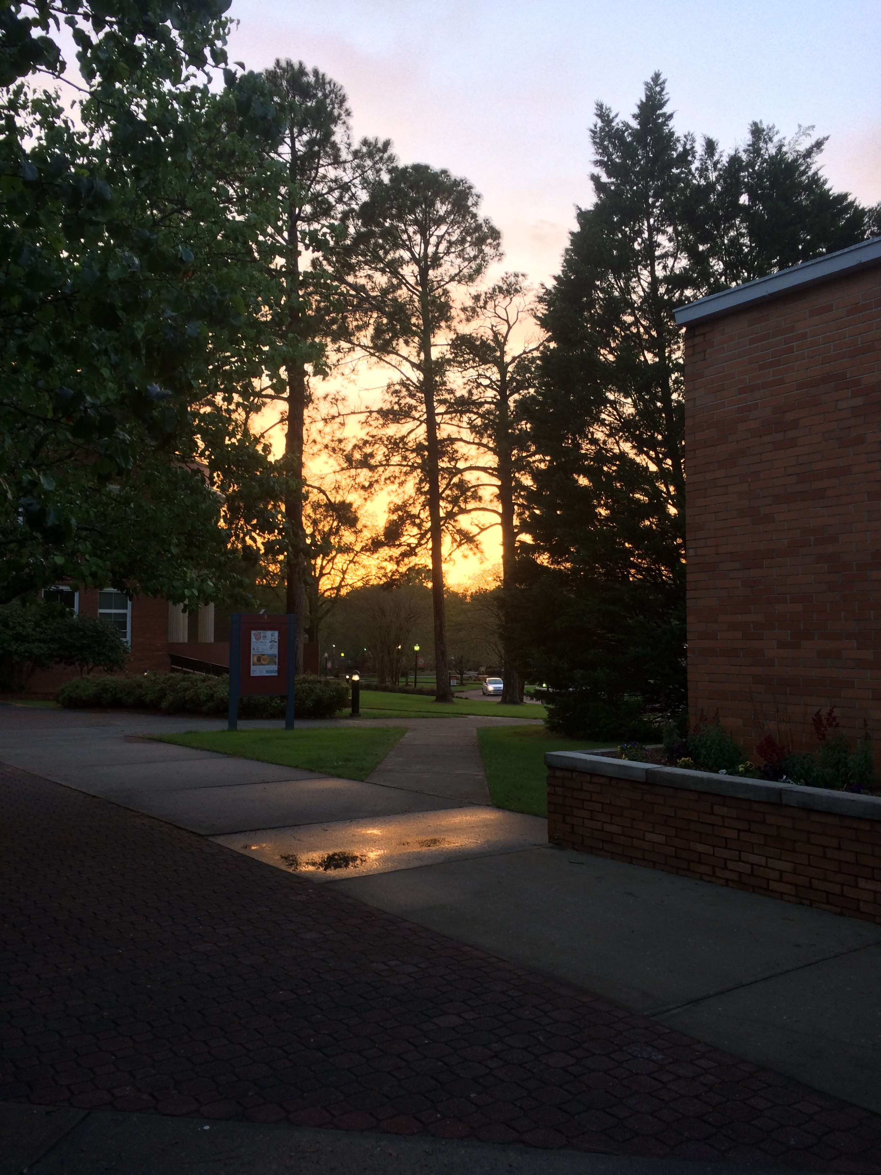
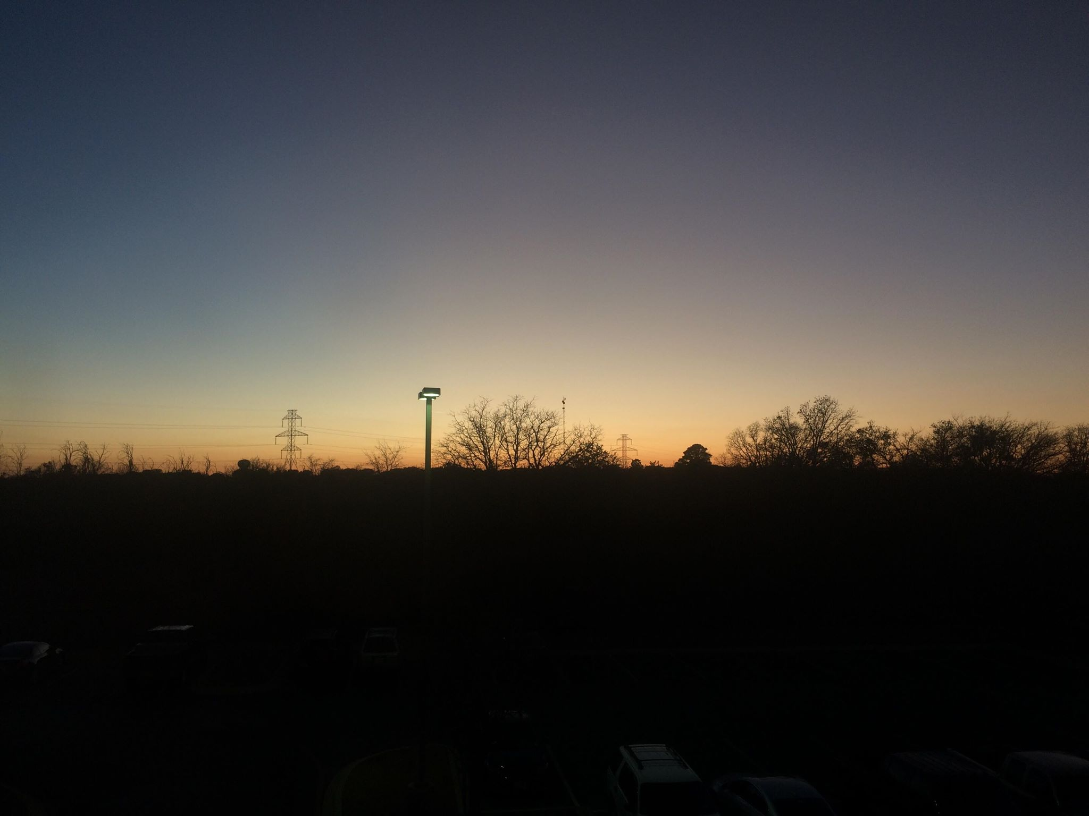
Typically fails at taking artistic photos

Slide 7










Can speak and/or understand these Languages
In progress
I want to learn:

Slide 8
Quiz nr1
Where did Mr. Xhafaj graduate?
South Dakota
South Carolina
South Africa
South America
Which kind of pet does Mr. Xhafaj prefer?
Parrot
Dog
Cat
Bulbasaur
Does Mr. Xhafaj prefer eating fast food or eating well?
Which one of these was a research area Mr. Xhafaj has done research in?
Oscillatory Integrals
Aerodynamics
Kinesiology
Girih Tiles

